Slide 1
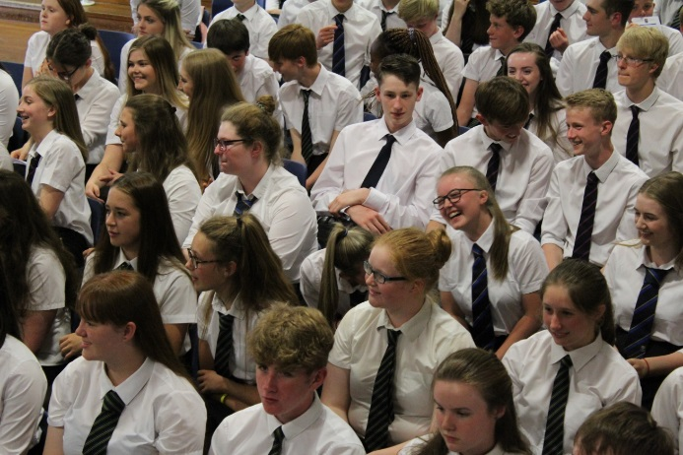


SENIOR PHASE Pathways
Current s3
2022-2023
To enable every student to achieve their unique and magnificent potential.

Slide 2
By the end of this assembly we hope that you have…
an understanding of our curriculum rationale
more information about the subjects on offer at SHS
an understanding of the course choice process and timeline
greater confidence for parent/carers in supporting your child in making their subject choices
greater confidence for students in understanding the progression pathways that are available to them.
Please let us know by giving your feedback.

Slide 3
Curriculum

Slide 4

Qualifications, Skills and Values
Selkirk High School Achievement Journey
Education Scotland
Pupil views
Parent views
Teacher views
Local and National Employment trends
This year we have enhanced our Curricular offer to meet the needs of students.

Slide 5

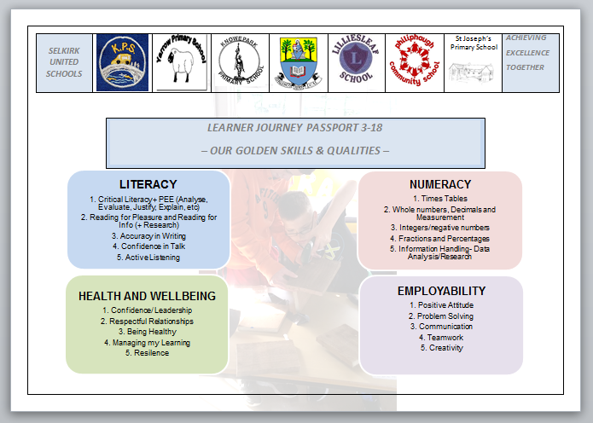
BGE (S1-S3)
All curricular areas
Specialism in S3
Golden Skills
Values

Slide 6

Senior Phase
SQA Qualifications
Level appropriate https://scqf.org.uk/about-the-framework/interactive-framework/
Progression through S4-S6
Career Pathways

Slide 7


Slide 8
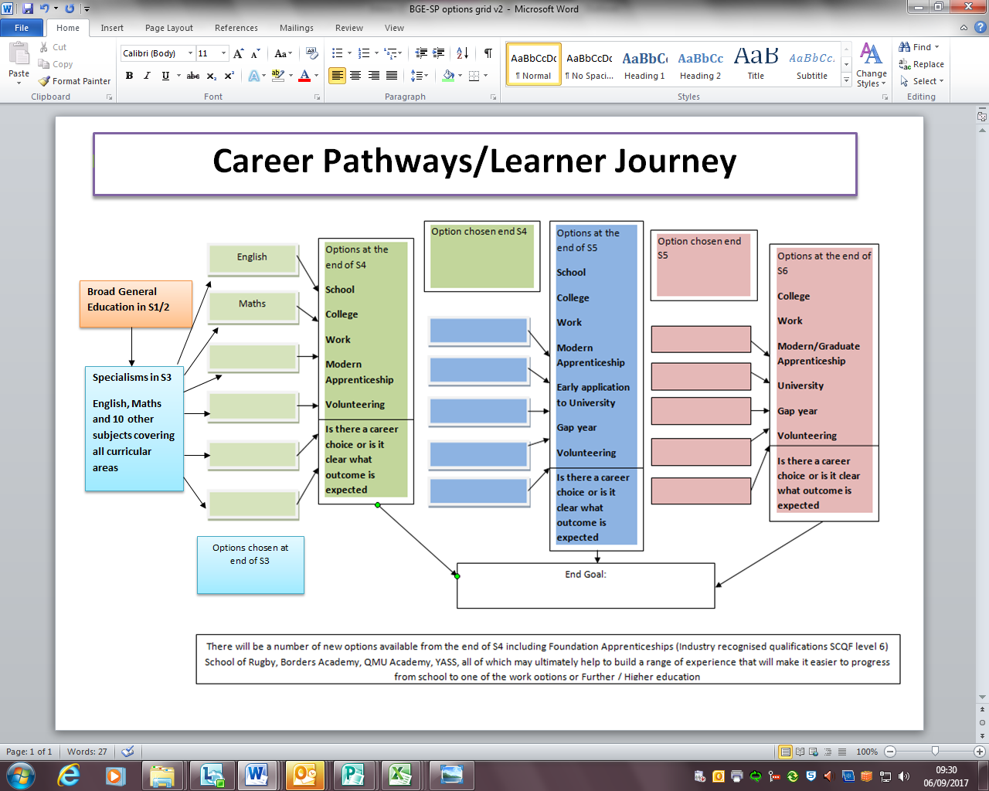

Slide 9
Useful interactive tools for subject choice.
https://www.myworldofwork.co.uk/my-career-options/where-can-subject-choices-take-you
https://www.myworldofwork.co.uk/my-career-options/how-choose-school-subjects
https://www.myworldofwork.co.uk/tools/subject-choices
https://www.myworldofwork.co.uk/my-career-options/job-categories

Slide 10
Animals, Land and Environment - Gamekeeper
Primary Education
S1 – S3 Broad General Education
1
2
S4
N4/N5 (English; Maths; Sciences; Geography; Technologies; Business Studies
College – Gamekeeping Modern Apprenticeship (SCQF Level 5)
3
S5
S6
4
Higher (English; Maths; Geography; Technologies; Business Studies)
OR
College – Gamekeeping NC (SCQF Level 6)
Higher/Advanced Higher (English; Maths; Geography; Technologies; Business Studies)
OR
College – Game and Wildlife Management HNC (SCQF Level 7)
5
Skills
Resilience Positive attitude Taking responsibility Taking initiative Developing a plan
Attention to detail Listening Verbal communication Written communication Cooperating

Slide 11
Healthcare – Midwife
Primary Education
S1 – S3 Broad General Education
1
2
S4
N4/N5 (English; Maths; Biology)
Borders College Schools Academy (Psychology; Care)
3
S5
S6
Higher/Advanced Higher (English; Maths; Human Biology)
Borders College Schools Academy (Psychology; Care)
Year 2 of Foundation Apprenticeship
Leading to University - Bachelors Degree in Midwifery
4
Higher (English; Maths; Human Biology)
Borders College Schools Academy (Psychology; Care)
College – Foundation Apprenticeship in Social Services and Healthcare (SCQF Level 6)
5
Skills
Resilience Taking responsibility Making decisions Developing a plan Listening
Verbal communication Supporting Social conscience Empathising Researching

Slide 12
Computing and ICT – Games Developer
Primary Education
S1 – S3 Broad General Education
1
2
S4
N4/N5 (English; Maths; Physics; Computing; Technologies)
3
S5
Higher (English; Maths; Physics; Computing; Technologies)
OR
College – Computing NC (SCQF Level 6)
College – Foundation Apprenticeship Computing and Digital Media (SCQF Level 6)
S6
4
Higher/Advanced Higher (English; Maths; Physics; Computing; Technologies)
OR
College – Computing HNC (SCQF Level 7)
Year 2 of Foundation Apprenticeship
5
Skills
Adaptability Working with technology Written communication Creative Analysing
Problem solving Researching Attention to detail Developing a plan Making decisions

Slide 13
Find out about more Pathways
PLANIT +

Slide 14
OPTIONS Examples
S4 Examples
6 Level 4/5 For the majority will include English and Maths/Application of Maths
5 Level 4/5 2 x Curricular Enhancement Level 4/5
5 Level 4/5 College Course
Notes:
EXPECTATIONS -
Your choices are informed.
Your choices take into account where you want to be in 1/2/3 years time and beyond.
Your choices allow you to progress and challenge yourself over time.
Your timetable is full with every period accounted for including directed study.
You are in school following your timetable (including study) at all times unless you have college/work experience etc.
CAITLYN RIDDELL

Slide 15
Course choice sheet

Slide 16
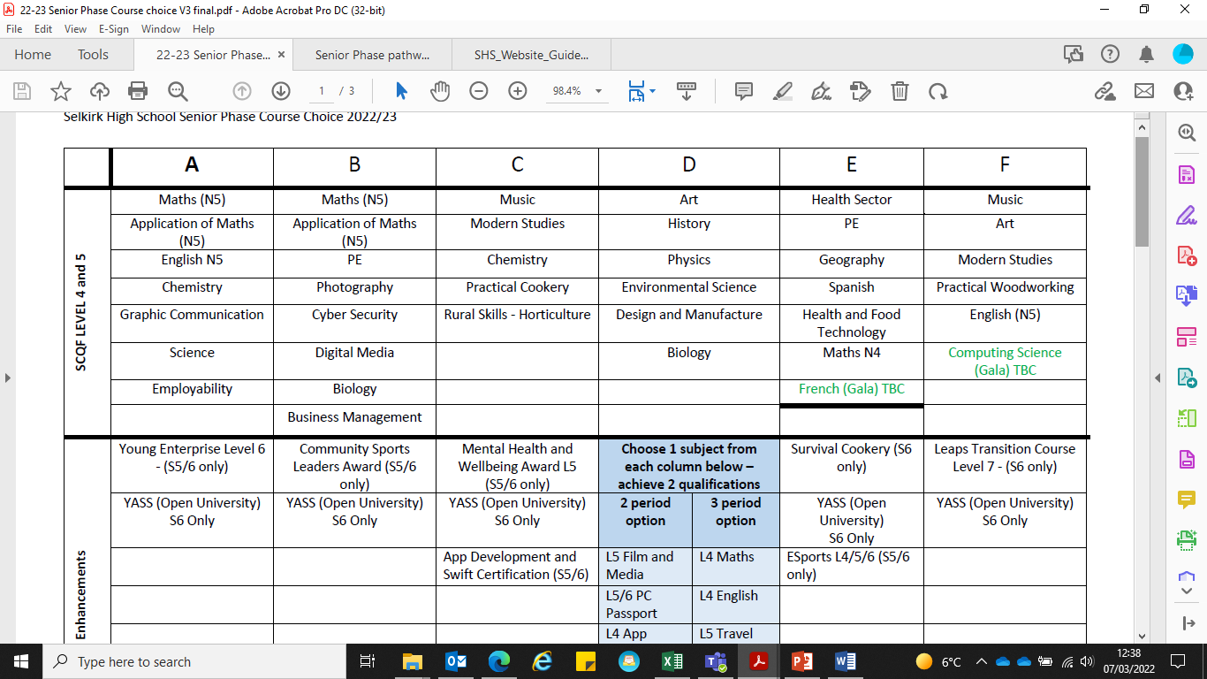

Slide 17
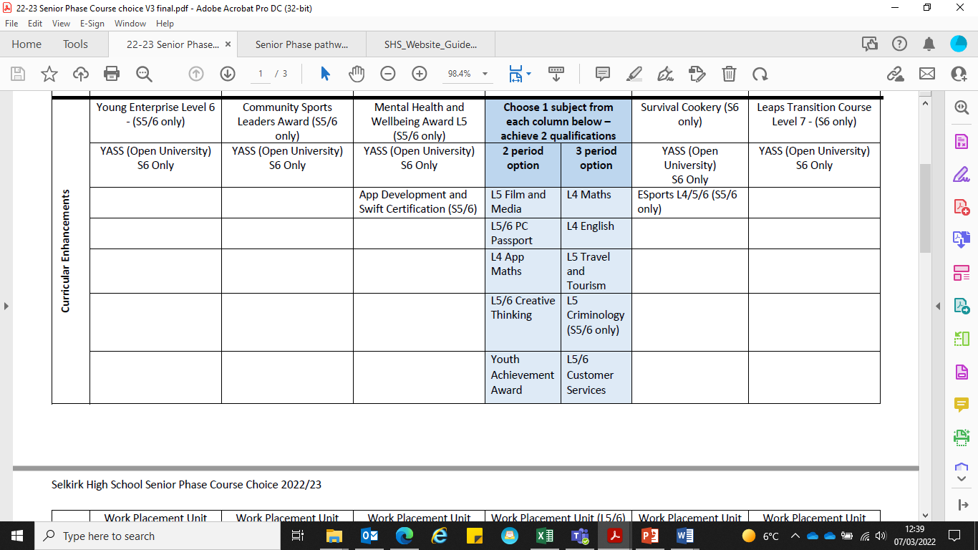

Slide 18
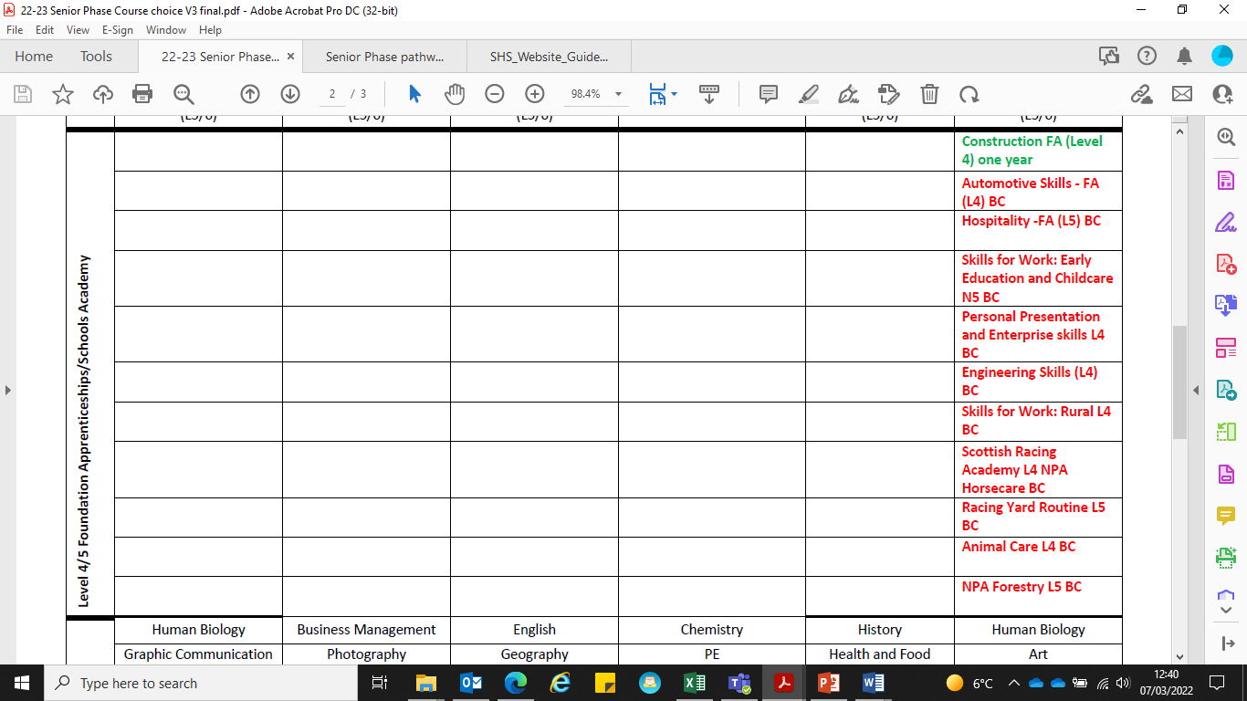

Slide 19
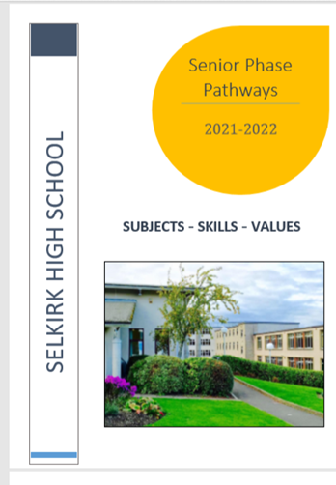
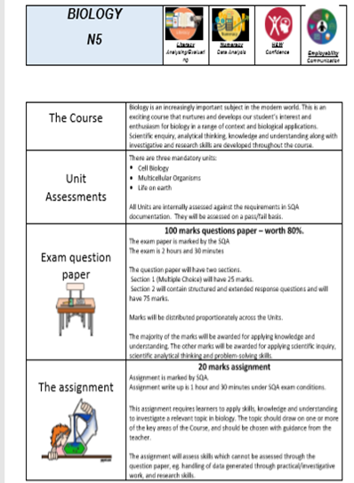
Making informed choices
Teams – Senior Phase Pathways booklet

Slide 20

Schools Academy
Our Schools Academy provides senior phase pupils the opportunity to learn a range of vocational skills, both practical and academic, whilst still attending school.
Web: www.borderscollege.ac.uk/courses/schools-academy/
E-mail: schoolsacademy@borderscollege.ac.uk
Notes:
If you successfully complete a Schools Academy programme that is directly related to one of our full-time courses (such as Hairdressing), and have satisfactory references, you will be offered a place on a related full-time course at Borders College the following year.

Slide 21

Who can help?
Pastoral Teachers
SHS Senior Phase Pathways booklet
Most recent school report
Subject teachers
School website
Careers Coach (Karen Turton)
Parents/Relatives
Friends
Employers
Training providers
My World of Work website
Planit+ website
UCAS website
DYW Website
Notes:
As well as the information from tonight…

Slide 22
Next sTEPS
Students/parents/carers discuss course choice at home.
All current S3-S5 students will have a 1:1 meeting with their Pastoral teacher over the next few weeks to discuss progression pathways.
Complete the Course Choice sheet.

Slide 23
Feedback/questions
Contact your Pastoral Teacher
Email me – gw09deanvicki@glow.sch.uk
Comment on the Course Choice thread on the year group Teams if you would like to ask a question.

