Slide 1
S5 Assembly
December 2023

Slide 2
QUALIFICATIONS
Winter Assessments
Continuous Assessment
Coursework

Slide 3
Winter Assessments/Continuous Assessment
This session, there will be a mix of assessments: some will be more formal, in the hall and take place the first week after the Christmas holiday; assessments taken during class time; continuous evidence gathering throughout the year. The timetables provide information of when set assessments will take place. Use the blank timetable at the back of this booklet to create your own assessment timetable.
Advice given to you by your subject teachers should help prepare you for these assessments. Please remember it is your responsibility to plan your study and be fully ready for all of your assessments as they allow both you and your teacher to see where you are currently in your learning and what specific next steps are needed.
The assessments will take place in different areas (e.g. normal classroom or gym hall), check locations carefully when creating your own timetable.

Slide 4
Please note the following when using the timetable:
1. Any students that require special arrangements to be made for assessments will be advised of the times and locations by Mr Lee/Miss Blair. These may differ from the main timetable.
2. Please take some time to read the information at the back of the booklet on assessment conduct. Invigilators that we use during the main exams will be conducting some of the assessments. The SQA take assessment conduct very seriously and it is important that we follow the guidance during these Winter Assessments to fully prepare you for the main exams in May.
3. Punctuality and attendance at all assessments are very important. If you are going to miss an assessment due to illness, please let the office or class teacher know.
Finally, if you have any questions regarding the timetable, please speak to the appropriate class teacher or Miss Blair as soon as possible.

Slide 5
SQA COURSEWORK
Coursework refers to all written or practical assessments you are doing (not including exams) – portfolios, practical activities, performances, assignments or projects.
National 3&4; Skills for Work courses; National Progression Awards do not have a final exam and are awarded a pass or fail. They involve completing unit assessments throughout the year.
It is important that you work to all deadlines set by your teacher as these are required to be met by the SQA

Slide 6
AI
There are now several AI tools but the text they produce can be incorrect or contain biased information
SQA state that you must not use or reference AI tools as sources for your coursework.
References to AI tools as a source will not receive any marks.

Slide 7
PLAGIARISM
Plagiarism is passing off someone else’s work as your own and is classed as cheating. It’s where you include words from another source but don’t reference them e.g. quotations
You are plagiarising if:
Some or all of you work has been produced by someone else
It’s been done by someone who has produced similar work in the past
It’s example work that has been prepared by your teacher
You’ve copied it from another source e.g. book, website, etc.
You have copied the work from an AI tool.

Slide 8
Don’t risk it
SQA uses software that identifies plagiarism.
You will lose your grade and other qualifications can be called into question
It does happen!

Slide 9
Independent Study

Slide 11
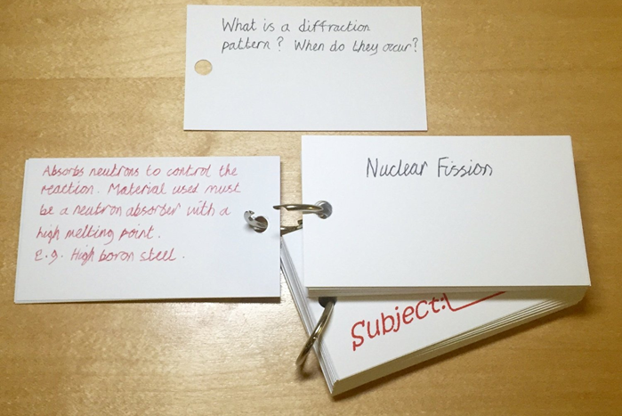
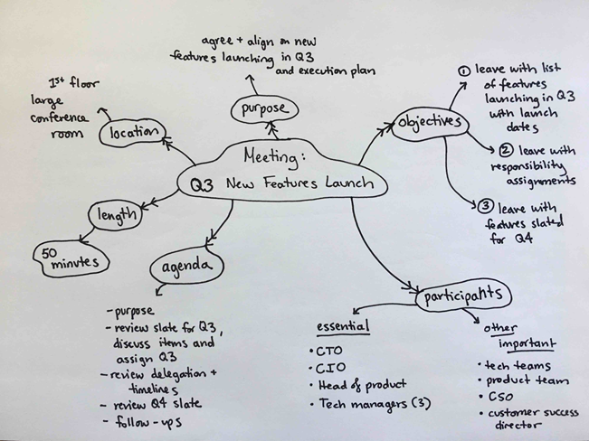
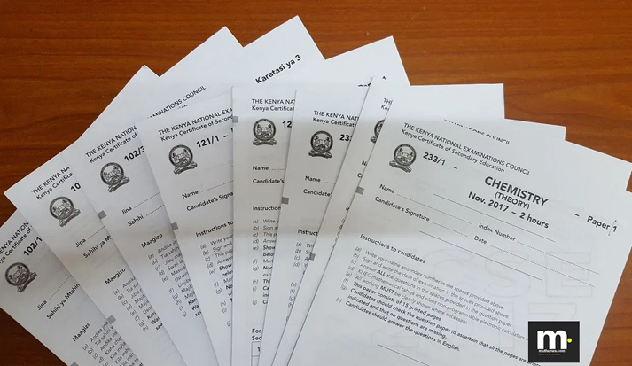
Exploring Different Revision Techniques
Highlighting
Mind Maps
Voice Notes
Flashcards
Past Papers
Boost your revision!
Try these different revision techniques and see what works best for you.
Selkirk High School
Revision Techniques.pptx

Slide 12
SENIOR STUDY SKILLS GUIDE
Study timetable

Slide 13
Interactive Study Skills guide – on Showbie
Study timetable to be completed by 15th December and will be discussed in PSE.

Slide 14
Prioritising your Revision Plan
It’s important to know what topics/aspects of the exam you need to focus on so that your revision time is not wasted on what you are already confident with.
Feedback from your teachers will help you decide on the priorities for each subject. Use the table to record your priorities for each subject so that you can constructively plan a revision timetable.
This should be completed again after your Winter Assessments.

Slide 15
Available Study Time Calculator
You will find a blank grid for you to fill in and calculate where to plan some study time.
This will help you to focus on your existing commitments and to see where you have blocks of time available to concentrate on your studies.
Remember to also include time you have available in school e.g. study periods. Read through the instructions carefully

Slide 16
HOW TO FOCUS YOUR STUDY TIME
You have already identified the priorities for each of your subject area and now know how much time you can commit to studying each day, now you need to focus your study time.
Each subject’s priorities need to be broken down into ‘chunks’ of learning.
For example, one of my priorities for English is to improve Critical Essay writing. This tells me what part of the exam I need to improve but it doesn’t help me to plan what I do when I sit down on a Monday to start my hour and a half of study time. I need to break Critical Essay down into specific focuses that I can achieve during each study session e.g. one session may focus on creating a characterisation mind-map with quotations; another may be on using a past paper to plan an essay response.
Use the table to plan your focus for each subject for the first 2 weeks of study. You should then plan some time every week to fill in your study focus for the following week.
After each study session, colour code the focus you worked on: Green – you are confident; Amber – you need to do more sessions to become confident; Red – you need further help with this focus.

Slide 17
Creating your Study Timetable
Once you have now completed all of the preparation work to create a weekly study timetable you can now start filling it in.
Your study timetable may look different every week – depending on what you are prioritising and focussing on.
At the end of this booklet, you will find further blank weekly study timetables.
Remember to look back at the study time available for each day; what your priorities are and what your specific focuses are for each subject

Slide 18
 | 9-10am | 10-11am | 11-12 | 12-1pm | 1-2pm | 2-3pm | 3-4pm | 4-5pm | 5-6pm | 6-7pm | 7-8pm | 8-10pm
Mon
Tue
Wed
Thur
Fri
Sat
Sun

Slide 19
REVISION TIPS AND TECHNIQUES
Working Environment
Set up your study space – Your study space should be quiet, comfortable and distraction-free. It should make you feel happy and inspired. Decorate it with your favourite pictures or objects. Keep it free from distractions! If you need a suitable study space for in-school study please see Miss Blair.
Find your best time – Some people work better in the morning. Others work better at night. Work out which time suits you and plan to study then. Don't study much later than your usual bedtime – pushing yourself late at night can make you too tired to study effectively.

Slide 20
Have a plan and break it down - Use all of the tools provided to create a clear plan and a clear focus for each of your study sessions. This can be adapted as you work through each week, taking into consideration the priorities you have.
Set clear goals - What do you want to achieve each study session. Master a skill you have been struggling with? Recall important facts? Write an essay plan? Having a set goal will enable you to focus your mind.
Short Bursts - Some people plan to sit for 3 hours solid to study but this isn’t always productive. It is better to have short 30 minute or so sessions with a 15-minute break. This keeps you fresh and enables you to process the information you have been revising.
Your Wellbeing - Preparing for exams can be stressful and sometimes you can do too much. It’s important to take some down time – go for a walk, spend time with friends/family, watch a film, listen to music, be creative. Make sure you take the time to do the things that help you relax!

Slide 21
Subject | Day | Time | Level | Location
Business Management | Wednesday | 12.45-13.15 | National 5/Higher | Room 14
Geography | Wednesday | After school | Higher | Room 36
Graphic Communication | Tuesday | Lunchtime | National 5/Higher | Room 20
English | Monday | 15.45-16.30 | All Levels | Room 21
Physics | Tuesday | Lunchtime | All Levels | Room 28
Art & Design/Photography | Thursday Monday | 15.45-17.00 Lunchtime | All Levels | Room 32/34
Modern Studies | Monday | Lunchtime | National 5/Higher | Room 31/35
Modern Studies | Thursday | 15.45-16.30 | N5/H/AH | Room 31
History | Tuesday | 15.45-16.30 | All Levels | Room 37
Maths | Tuesday | 15.45-16.30 | All Levels | Room – maths corridor
Maths | Tuesday | Lunchtime | All Levels | Room – maths corridor
Health and Food Tech | Wednesdays | Lunchtime | National 5/Higher | Room 3
Music | Tuesday/Wednesday | After School | All levels | Room M1
Biology | Monday | After School | All Levels | Room 29
Physical Education | Wednesday | 13.30-14.00 | Higher | PE
Travel & Tourism | Monday | lunchtime | National 4 and 5 | Room 35

Slide 22
ASK FOR HELP!
USE STUDY SUPPORT
FOCUS ON THE END GOAL
19 WEEKS UNTIL SQA EXAMS START!

