Slide 1
S4 Assembly
OCTOBER 2023

Slide 2
S4 Expectations
You must be in all classes – including core(PSE, PE) and RTL
Below 95% attendance has an impact on attainment outcomes.
45/80 students in S4 currently have below 95% attendance = 56%
Big Question?
What are the barriers to better attendance?

Slide 3
You must not leave school grounds other than at lunchtime
Mobile phones must not be out in classes or between classes.
You must set high standards of behaviour – you are role models to our younger students.
Uniform must be worn – even if you have PE

Slide 4
How to manage the attainment expectations of S4
Some formal timetabled prelims in January – information issued soon.
Some subjects doing little and often assessment activities to measure progress and develop next steps – how to improve.
Senior Phase report – what to do with the information
Study support
Esgoil - Study Support 2023-24 | e-Sgoil
Your own independent study – what does this look like?

Slide 6
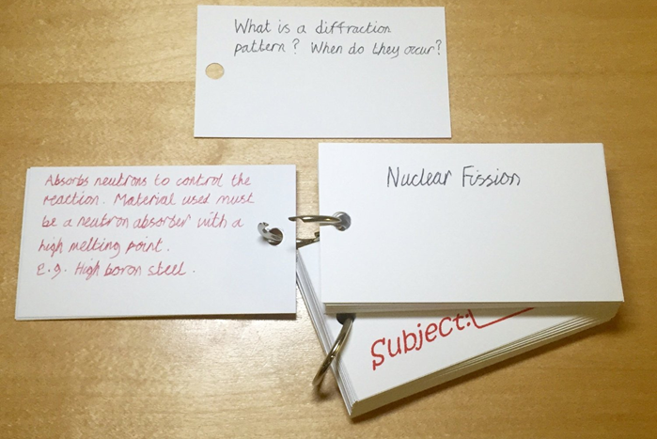
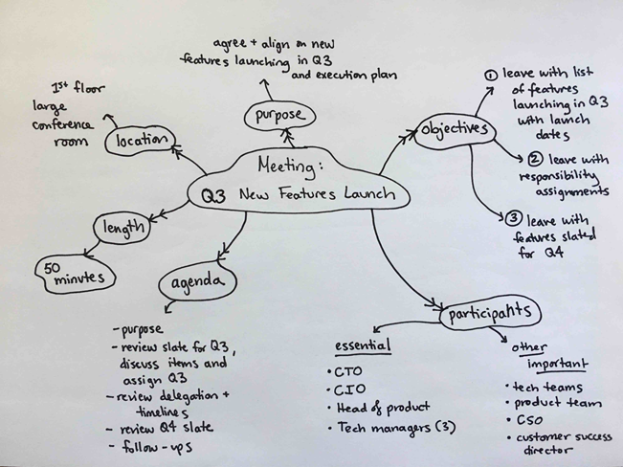
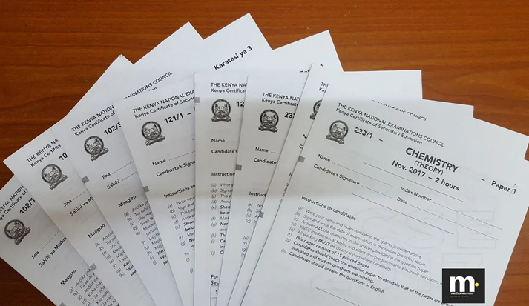
Exploring Different Revision Techniques
Highlighting
Mind Maps
Voice Notes
Flashcards
Past Papers
Boost your revision!
Try these different revision techniques and see what works best for you.
Selkirk High School
Revision Techniques.pptx

Slide 7
Using highlighting to boost your revision
Highlighting is not:
A strategy that will help you remember lots of information.
Highlighting is:
A technique that can help you identify what to revise.
Highlighting should:
Identify the key concepts and words in a text.
Use colour coding
Colour coding can help remind you why you decided to highlight a certain section of the text. For example, you might highlight the quotes in 'Romeo and Juliet' that are connected to the theme of love in one colour and the quotes that are connected to the theme of conflict in another colour.
Read the text first
Firstly, focus on reading the text without thinking about what to highlight. Until you know the full context of the page or paragraph, it's difficult to know what is important and what is not.
Only highlight key information Highlighting entire paragraphs is similar to highlighting nothing at all! If you struggle with selecting what to highlight, set a clear goal for highlighting. For example, "I'm going to highlight the three main points on this page" or "I'm only going to highlight key terms and their definitions".
View highlighting as a starting point
Research suggests that highlighting alone is unlikely to be helpful in boosting your memory. However, it can help you to identify the key information you will need to move on to other revision strategies. For example, if you have highlighted key words and their definitions, you could turn these into flashcards.

Slide 8
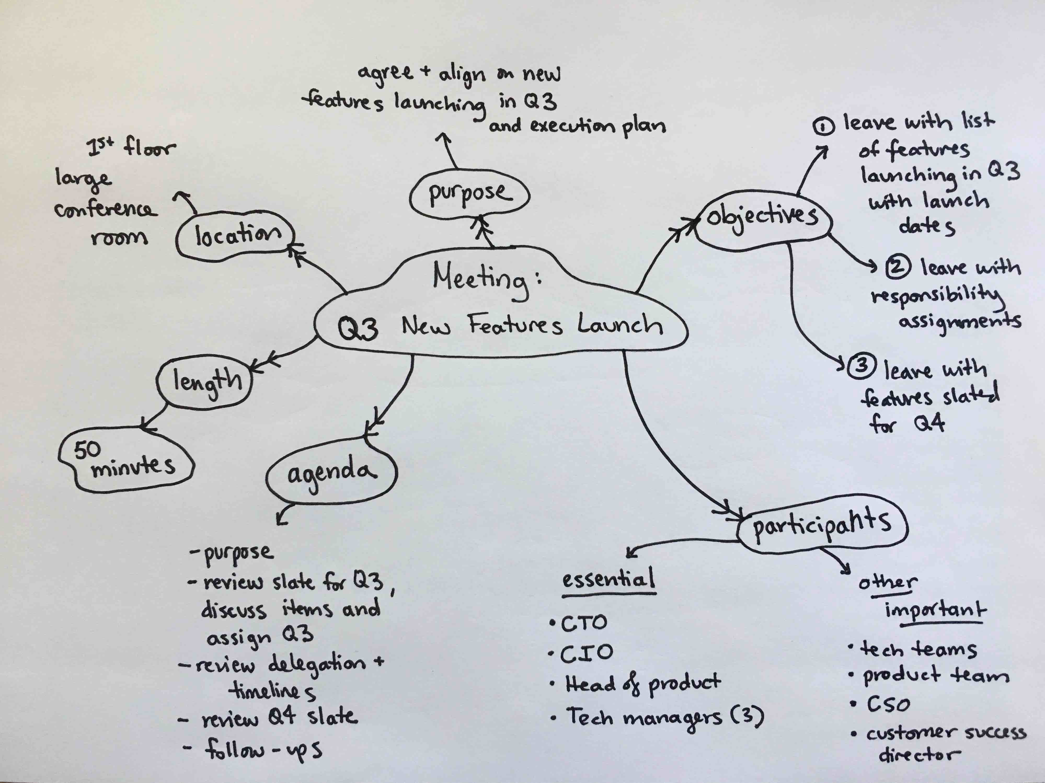
How to make your mind maps more effective
Mind maps are not:
A strategy to write down everything you know about a topic in depth.
Mind maps are:
A way to show links between pieces of information, branching out from the central topic in the middle.
Mind maps should:
Contain key words and no more than 6-8 sections branching out directly from the central topic.
Try to create mind maps without your notes
Mind maps can be a great way to figure out what you can't remember.
Try to create a mind map on a topic from your memory alone.
If some branches are more empty than others, you will know where to focus your revision efforts.
Revisit your mind maps
Remember not to file your mind map away without actively revisiting it.
You could try to recreate the mind map a few days later to see if you can still recall the information on it, or you could create flashcards that go into detail on each of the keywords in your mind map.
Include key words
The more you can condense the information on your mind map, the better!
Mind maps can be a great resource to help you quickly make associations between key words, creating a clear overview of a topic. Do not use them to create an in-depth review of topics.
Using images in your mind maps
Images and icons can be useful to include, but only if they include relevant information and you will be able to remember the meaning of them later on.
Do not spend a long time drawing unnecessary images just to add to the appearance of the mind map.

Slide 9
Using voice notes to boost your revision
Voice Notes are not:
Recordings you can simply play in the background without paying attention to.
Voice Notes are:
A technique that can help you revise on the go.
Voice Notes should:
Provide you with clear audio summaries of different topics. .
Six Top Tips
Do a short test recording first. You don't want to record for 10 minutes only to find your microphone isn't working!
Find somewhere quiet to record, and speak as clearly as possible. This will make the information in your voice notes easier to focus on when you listen back.
Plan what you will say in advance. This will help you to include everything you need to. The act of writing a script for each topic will also boost your memory retention.
When you save your recordings, give them a clear name so that you can easily find them later on.
Avoid listening to your notes while you're actively focussing on something else. For example, if you try to play your voice notes in the background while reading through other notes, you won't be able to focus on both pieces of information.
Try to only cover one topic per recording. This will mean that you won't have to search through a very long recording to find one particular topic when you listen back.

Slide 10
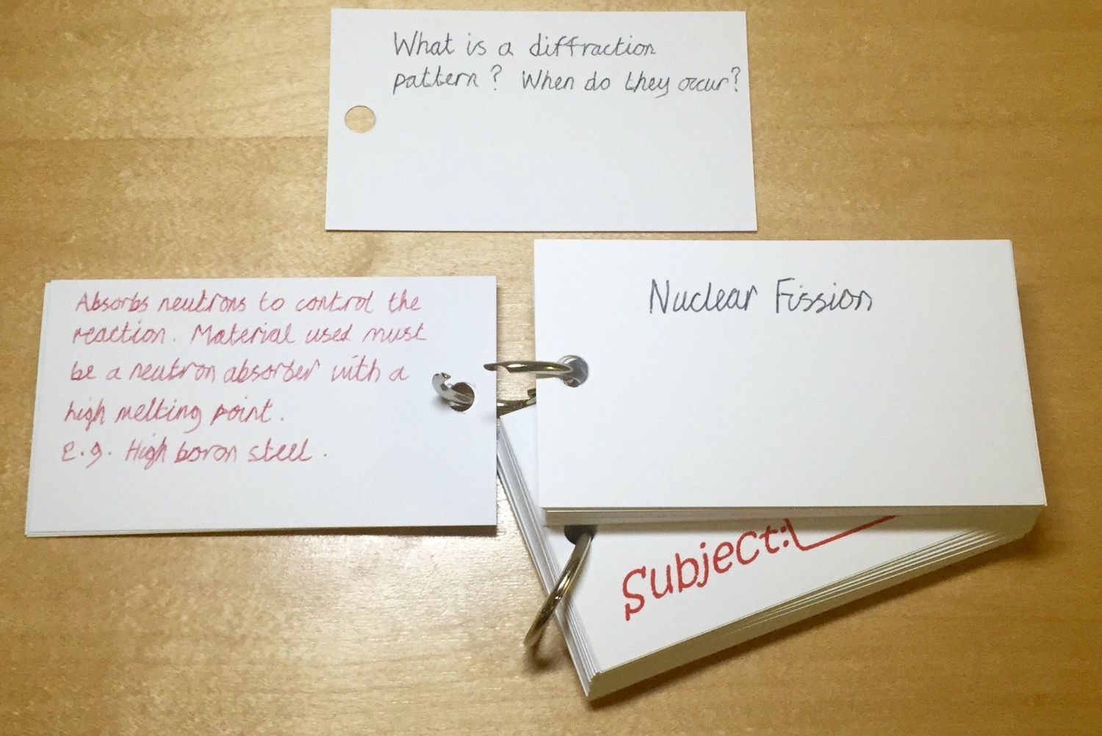
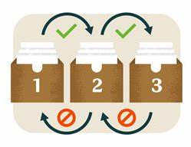
Using flashcards to boost your revision
Flashcards are not:
A strategy to summarise information.
Making flashcards
On one side, write a question or a key term.
On the other side, write the answer to the question or the definition of the key term.
Flashcards are:
A revision technique that should be used for testing and recall.
Flashcards should:
Only contain one idea..
The Leitner System
For this strategy, you will need three boxes large enough to fit your flashcards.
Step 1: Start by trying to recall the information on each card.
Step 2: Move the cards you were able to recall into box 2, and keep any you weren’t able to recall in box 1.
Step 3: Revisit box 1 the next day.
Step 4: Three days later, revisit the flashcards in box 2. If you are still able to recall the information on them correctly, move them to box 3 and revisit them in five days.
Step 5: Five days later, if you cannot recall information from the flashcards in boxes 2 and 3, move them back to box 1.
Step 6: Start the whole process again!

Slide 11
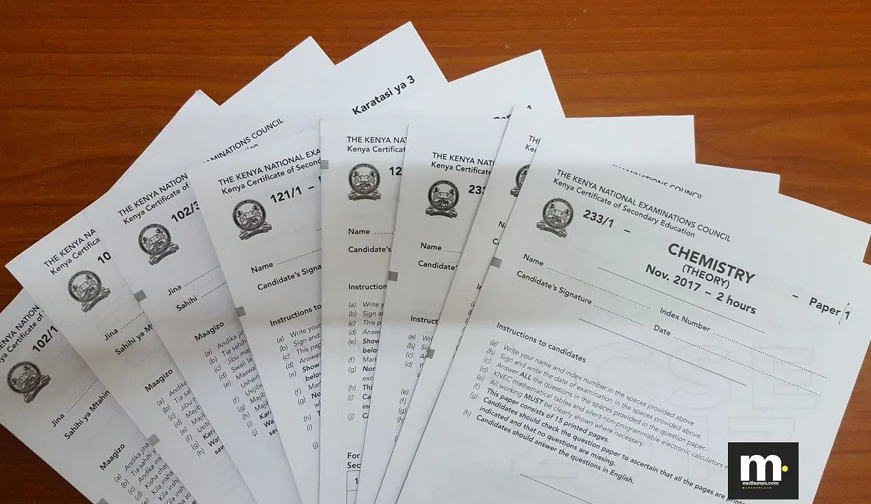
Using past papers to boost your revision
Past Paper Practice is not:
A test to see what you can remember.
Past Paper Practice is:
A revision technique that should be used for developing exam techniques and practising recall.
Past Paper Practice should:
Be completed with revision notes to begin with. Then, as you get used to the style of questions, it can be used to identify topics that need revising.
Increasing expertise & confidence
Stage 1: Using revision resources
Choose 1-3 questions at a time, do not attempt to complete a whole paper. Use your resources to try and answer the questions, then improve the answers by using the mark scheme.
Stage 2: Be specific — try to not use resources
Choose a specific topic or style of question, for example 'calculate..', or 'describe...’. Try to answer questions without any resources. However, if you get stuck, use a resource as a prompt to help you remember. Give yourself 5 lives before starting. When you check your resources, take off a life. When you repeat the process, reduce the number of lives.
Stage 3: Using questions to identify areas of focus
Without any resources, set yourself a time limit of 1 hour.
Try following this schedule:
0-5 min: Get everything you need (e.g. pens, pencils, calculator...).
5-35 min: Answer as many questions as possible.
35-40 min: Have a five minute break.
40-50 min: Mark and improve.
50-60 min: Identify areas that need to be worked and add them to your revision schedule.

Slide 12
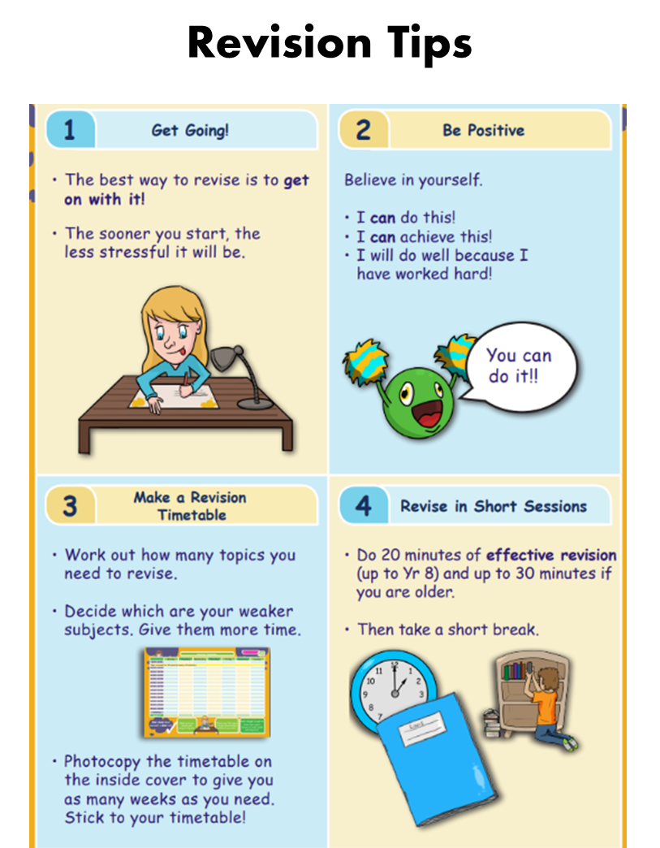

Slide 17
More Revision Tips

Slide 18
Study Time Calculator
Study timetable

Slide 19
 | 9-10am | 10-11am | 11-12 | 12-1pm | 1-2pm | 2-3pm | 3-4pm | 4-5pm | 5-6pm | 6-7pm | 7-8pm | 8-10pm
Mon
Tue
Wed
Thur
Fri
Sat
Sun

Slide 20
Subject | Day | Time | Level | Location
Business Management | Wednesday | 12.45-13.15 | National 5/Higher | Room 14
Geography | Wednesday | After school | Higher | Room 36
Graphic Communication | Tuesday | Lunchtime | National 5/Higher | Room 20
English | Monday | 15.45-16.30 | All Levels | Room 21
Physics | Tuesday | Lunchtime | All Levels | Room 28
Art & Design/Photography | Thursday Monday | 15.45-17.00 Lunchtime | All Levels | Room 32/34
Modern Studies | Monday | Lunchtime | National 5/Higher | Room 31/35
Modern Studies | Thursday | 15.45-16.30 | N5/H/AH | Room 31
History | Tuesday | 15.45-16.30 | All Levels | Room 37
Maths | Tuesday | 15.45-16.30 | All Levels | Room – maths corridor
Maths | Tuesday | Lunchtime | All Levels | Room – maths corridor
Health and Food Tech | Wednesdays | Lunchtime | National 5/Higher | Room 3
Music | Tuesday/Wednesday | After School | All levels | Room M1
Biology | Monday | After School | All Levels | Room 29
Physical Education | Wednesday | 13.30-14.00 | Higher | PE
Travel & Tourism | Monday | lunchtime | National 4 and 5 | Room 35

Slide 21
ASK FOR HELP!
USE STUDY SUPPORT
FOCUS ON THE END GOAL
25 WEEKS UNTIL SQA EXAMS START!

