Slide 1
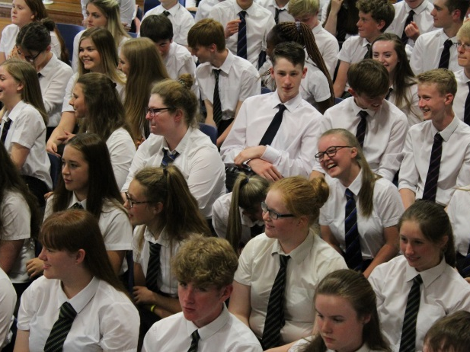
BGE Pathways 2024-2025
To enable every student to achieve their unique and magnificent potential.

Slide 2
We hope that you leave with…
an understanding of our curriculum rationale
more information about the S3 subjects on offer at SHS
an understanding of the course choice process and timeline
greater confidence in supporting your child in making their subject choices

Slide 3
Curriculum

Slide 4
Qualifications , Skills and Values Selkirk High School Achievement Journey
Education Scotland
Pupil views
Parent views
Teacher views
Local and National Employment trends
This year we have enhanced our Curricular offer to meet the needs of students including a number of courses which result in pupils achieving an SQA Qualification

Slide 5
BGE (S1-S3)
All curricular areas
Specialism in S3
Golden Skills
Values – Compassion, Courage and Integrity
Achievement Journey

Slide 6
Senior Phase
SQA Qualifications
Level appropriate
Progression through S4-S6
Career Pathways
S4 | SCQF Level 3/4/5 Qualifications English Maths Plus 4 (or 5) other subjects
S5 | 6 Subjects Progression from S4
S6 | A minimum of 4 qualifications SQA SCQF Level 6 Leadership Award Progression from S5

Slide 7
Animals, Land and Environment - Gamekeeper
Primary Education
S1 – S3 Broad General Education
1
2
S4
N4/N5 (English; Maths; Sciences; Geography; Technologies; Business Studies
College – Gamekeeping Modern Apprenticeship (SCQF Level 5)
3
S5
S6
4
Higher (English; Maths; Geography; Technologies; Business Studies)
OR
College – Gamekeeping NC (SCQF Level 6)
Higher/Advanced Higher (English; Maths; Geography; Technologies; Business Studies)
OR
College – Game and Wildlife Management HNC (SCQF Level 7)
5
Skills
Resilience Positive attitude Taking responsibility Taking initiative Developing a plan
Attention to detail Listening Verbal communication Written communication Cooperating

Slide 8
Healthcare – Midwife
Primary Education
S1 – S3 Broad General Education
1
2
S4
N4/N5 (English; Maths; Biology)
Borders College Schools Academy (Psychology; Care)
3
S5
S6
Higher/Advanced Higher (English; Maths; Human Biology)
Borders College Schools Academy (Psychology; Care)
Year 2 of Foundation Apprenticeship
Leading to University - Bachelors Degree in Midwifery
4
Higher (English; Maths; Human Biology)
Borders College Schools Academy (Psychology; Care)
College – Foundation Apprenticeship in Social Services and Healthcare (SCQF Level 6)
5
Skills
Resilience Taking responsibility Making decisions Developing a plan Listening
Verbal communication Supporting Social conscience Empathising Researching

Slide 9
Computing and ICT – Games Developer
Primary Education
S1 – S3 Broad General Education
1
2
S4
N4/N5 (English; Maths; Physics; Computing; Technologies)
3
S5
Higher (English; Maths; Physics; Computing; Technologies)
OR
College – Computing NC (SCQF Level 6)
College – Foundation Apprenticeship Computing and Digital Media (SCQF Level 6)
S6
4
Higher/Advanced Higher (English; Maths; Physics; Computing; Technologies)
OR
College – Computing HNC (SCQF Level 7)
Year 2 of Foundation Apprenticeship
5
Skills
Adaptability Working with technology Written communication Creative Analysing
Problem solving Researching Attention to detail Developing a plan Making decisions

Slide 10
More career/pathway information
Planit Plus
My World of Work
When making choices in S2 it’s important to consider which subjects you will choose in the Senior Phase

Slide 11
Select one option from each column C-F
Select 3 options from Section B

Slide 13
Who can help?
Pastoral Teachers
SHS BGE Pathways booklet
Most recent school report
Subject teachers
School website
Careers Advisor
Parents
Relatives
Friends
Employers
Training providers
My World of Work website
Planit+ website
Notes:
As well as the information from tonight…

Slide 14
TIMELINE
Week Beginning 25th March - S2 Reports
Week Beginning 25th March –Course Choice Assembly
Choices Information on Showbie – 25th March 2024
15th – 19th April Course Choice interviews with Pastoral. Pupils should bring their completed choice form to this meeting.

Slide 15
ANY QUESTIONS?

