Slide 1
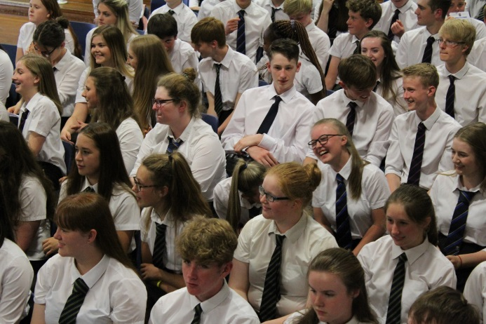

SENIOR PHASE Pathways
2024-2025
To enable every student to achieve their unique and magnificent potential.

Slide 2
By the end of this presentation, we hope that you have…
an understanding of our curriculum rationale
more information about the subjects on offer at SHS
an understanding of the course choice process and timeline
greater confidence for students in understanding the progression pathways that are available to them.
Please let us know by giving your feedback.

Slide 3
Curriculum

Slide 4

Qualifications, Skills and Values
Selkirk High School Achievement Journey
Education Scotland
Pupil views
Parent views
Teacher views
Local and National Employment trends
We have enhanced our Curricular offer to meet the needs of students.

Slide 5

BGE (S1-S3)
All curricular areas
Specialism in S3
Golden Skills
Values – Compassion, Courage and Integrity

Slide 6

Senior Phase
SQA Qualifications – National Qualifications, Skills for Work, National Progression Awards, other Awards.
Level appropriate https://scqf.org.uk/about-the-framework/interactive-framework/
Progression through S4-S6
Career Pathways
S4 | SCQF Level 3/4/5 Qualifications English Maths Plus 4 (or 5) other subjects
S5 | 6 Subjects Progression from S4
S6 | A minimum of 4 qualifications SQA SCQF Level 6 Leadership Award Progression from S5

Slide 7


Slide 8
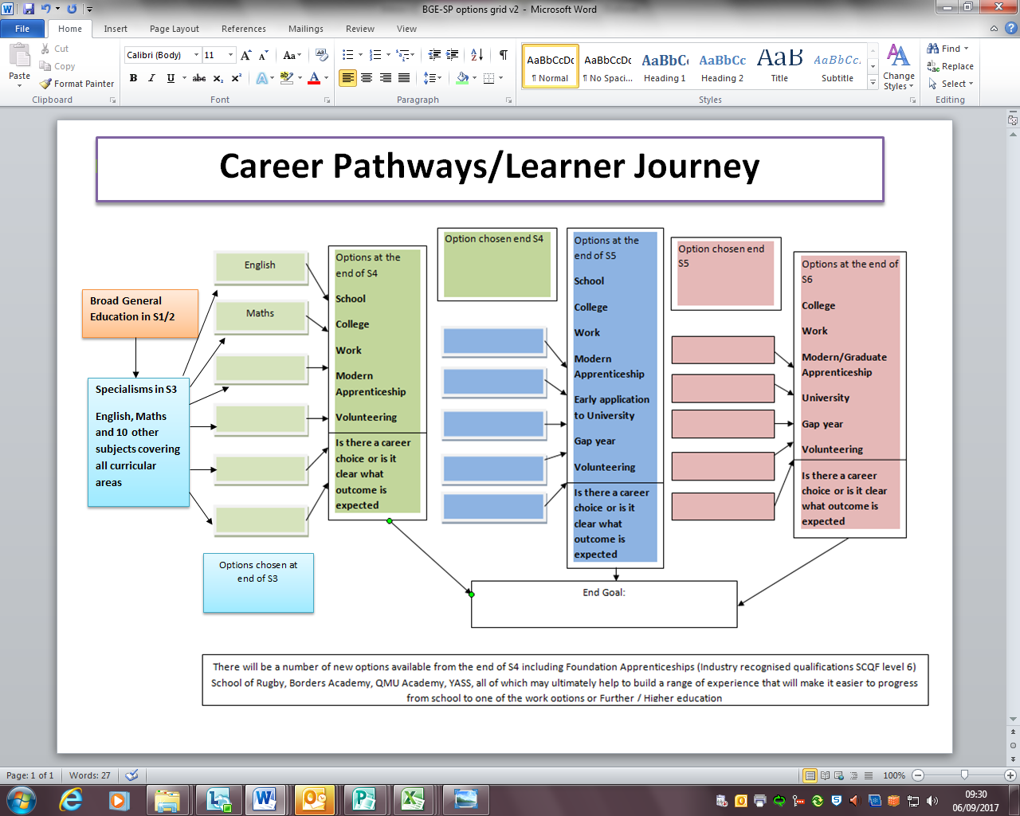

Slide 9
Useful interactive tools for subject choice.
https://www.myworldofwork.co.uk/my-career-options/where-can-subject-choices-take-you
https://www.myworldofwork.co.uk/my-career-options/how-choose-school-subjects
https://www.myworldofwork.co.uk/tools/subject-choices
https://www.myworldofwork.co.uk/my-career-options/job-categories
https://www.planitplus.net/Schools/CareerPathways/

Slide 10
Animals, Land and Environment - Gamekeeper
Primary Education
S1 – S3 Broad General Education
1
2
S4
N4/N5 (English; Maths; Sciences; Geography; Technologies; Business Studies
College – Gamekeeping Modern Apprenticeship (SCQF Level 5)
3
S5
S6
4
Higher (English; Maths; Geography; Technologies; Business Studies)
OR
College – Gamekeeping NC (SCQF Level 6)
Higher/Advanced Higher (English; Maths; Geography; Technologies; Business Studies)
OR
College – Game and Wildlife Management HNC (SCQF Level 7)
5
Skills
Resilience Positive attitude Taking responsibility Taking initiative Developing a plan
Attention to detail Listening Verbal communication Written communication Cooperating

Slide 11
Healthcare – Midwife
Primary Education
S1 – S3 Broad General Education
1
2
S4
N4/N5 (English; Maths; Biology)
Borders College Schools Academy (Psychology; Care)
3
S5
S6
Higher/Advanced Higher (English; Maths; Human Biology)
Borders College Schools Academy (Psychology; Care)
Year 2 of Foundation Apprenticeship
Leading to University - Bachelors Degree in Midwifery
4
Higher (English; Maths; Human Biology)
Borders College Schools Academy (Psychology; Care)
College – Foundation Apprenticeship in Social Services and Healthcare (SCQF Level 6)
5
Skills
Resilience Taking responsibility Making decisions Developing a plan Listening
Verbal communication Supporting Social conscience Empathising Researching

Slide 12
Computing and ICT – Games Developer
Primary Education
S1 – S3 Broad General Education
1
2
S4
N4/N5 (English; Maths; Physics; Computing; Technologies)
3
S5
Higher (English; Maths; Physics; Computing; Technologies)
OR
College – Computing NC (SCQF Level 6)
College – Foundation Apprenticeship Computing and Digital Media (SCQF Level 6)
S6
4
Higher/Advanced Higher (English; Maths; Physics; Computing; Technologies)
OR
College – Computing HNC (SCQF Level 7)
Year 2 of Foundation Apprenticeship
5
Skills
Adaptability Working with technology Written communication Creative Analysing
Problem solving Researching Attention to detail Developing a plan Making decisions

Slide 13
OPTIONS Examples
S4 Examples | S5 Examples | S6 Examples
6 Level 4/5 For the majority will include English and Maths/Application of Maths | 6 Level 4/5 OR 5 Level 4/5 + 2 Curricular Enhancement Courses OR College Course | A combination of – Level 7 Level 6 Level 5 YASS College Work Experience/ Volunteering Curricular Enhancement course Mandatory SCQF Leadership Award (resulting in a minimum of 4 qualifications) Expectation – full timetables.
5 Level 4/5 2 x Curricular Enhancement Level 4/5 | 5 Level 6 (Highers)
6 Level 4/5 College Course | 5 Level 6 Curricular Enhancement course
5 Level 4/5 1 x Curricular Enhancement Level 4/5 College course | 4 Level 6 (Highers) 2 Level 5
 | 4 Level 6 (Highers) Year 1 Foundation Apprenticeship College course

Slide 14
Course choice sheet

Slide 15



Slide 16
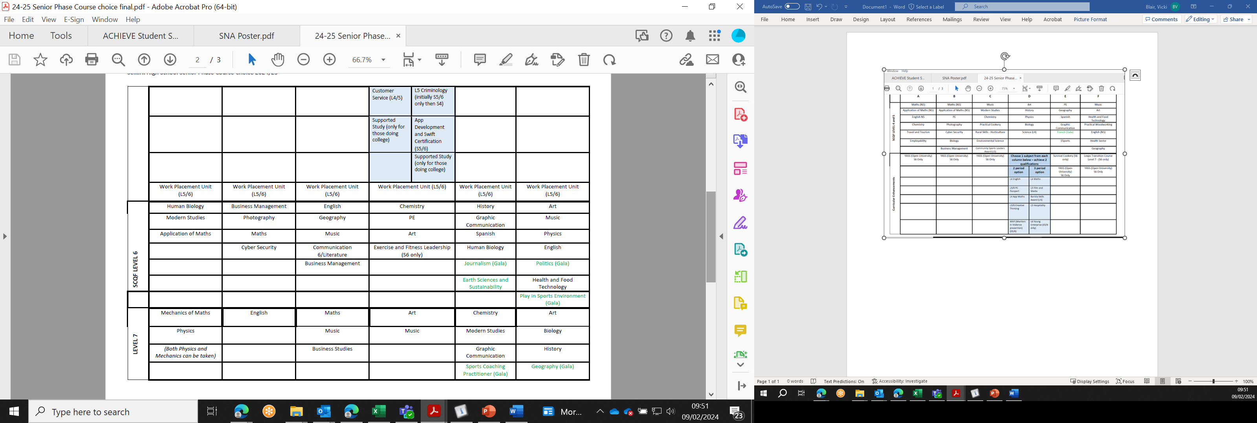

Slide 17


Making informed choices
Showbie/website – Senior Phase Pathways booklet

Slide 18

Schools Academy
Our Schools Academy provides senior phase pupils the opportunity to learn a range of vocational skills, both practical and academic, whilst still attending school.
Web: www.borderscollege.ac.uk/courses/schools-academy/
E-mail: schoolsacademy@borderscollege.ac.uk
Notes:
If you successfully complete a Schools Academy programme that is directly related to one of our full-time courses (such as Hairdressing), and have satisfactory references, you will be offered a place on a related full-time course at Borders College the following year.

Slide 19
BORDERS COLLEGE SCHOOLS ACADEMY
Kickstart your career while still at school
School partnership courses - for senior school pupils moving into S4, S5 and S6 in August 2024 - offer a wide range of vocational courses to study alongside school-based National and Higher qualifications. Our extensive range of courses are pitched at a range of levels to study at our Scottish Borders Campus in Galashiels (BC) or Newtown St Boswells (NSB)
Make Fridays Fun and join us at college to level up your skills and grab those qualifications that'll be the stepping stones to your future career! Schools Academy courses will take place on a Friday from 10am-2.30pm and transport will be provided between school and college. Pupils will need to ensure they can access transport home from Selkirk High School after the college transport as dropped them off.
If you are selecting one of the courses below, you can select one of the Supported Study options in column D above – this will give you time in school to catch up with work from other subjects.
Please tick the box next to the course you are interested in. More information about each course can be found at https://www.borderscollege.ac.uk/courses

Slide 20
Course | Level | Location | Course | Level | Location
Skills for Learning and Work | 3 | BC | Forestry – NPA | 5 | NSB
Scottish Racing Academy: NPA Horse Care | 4 | Yard/BC | Scottish Racing Academy: Racing Yard Routine – NPA | 5 | Yard/BC
Land-based: Rural Skills for Work | 4 | NSB | Foundation Apprenticeship: Hospitality | 5 | SBC
Animal Care (an introduction) | 4 | NSB | Local Food Production – NPA | 6 | NSB
Engineering | 4 | BC | Gym Instructor Award | 6 | BC
Foundation Apprenticeship: Automotive Skills | 4 | BC | Development Player Programme: Rugby | 6 | BC
Skills for Work: Early Education and Childcare | 4 | BC | Development Player Programme: Football | 6 | BC
Foundation Apprenticeship: Construction Craft & Technician | 4 | Gala | Psychology – Higher | 6 | BC
Beauty and Hairstyling – NPA | 4 | BC | Foundation Apprenticeship: Social Services and Healthcare | 6 | Online/BC
eSports – NPA | 5 | BC | Foundation Apprenticeship: Social Services Children and Young People | 6 | Online/BC
Development Player Programme: Rugby | 5 | BC | Cyber Security – NPA | 6 | BC
Cyber Security – NPA | 5 | BC

Slide 21

Who can help?
Pastoral Teachers
SHS Senior Phase Pathways booklet
Most recent school report
Subject teachers
School website
Careers Coach (Caroline Clarke)
Parents/Relatives
Friends
Employers
Training providers
My World of Work website
Planit+ website
UCAS website
DYW Website
Notes:
As well as the information from tonight…

Slide 22
Next sTEPS
Students/parents/carers discuss course choice at home.
All current S3-S5 students will have a 1:1 meeting with their Pastoral teacher to discuss progression pathways.
Some students may have an enhanced transition meeting where parents and other partners are invited to discuss all available options.
Complete the Course Choice sheet.

Slide 23
Timelinle
Wk beginning 5th February – S4/5 Course Choice Assembly
19th Feb-1st March – S4/5 Course choice meetings
Students should bring their completed course choice forms to their meeting with Pastoral

Slide 24
Feedback/questions
Contact your Pastoral Teacher
Email me – vblair@scotborders.gov.uk

